Slide 1
DATA HIDING USING STEGANOGRAPHY AND CRYPTOGRAPHY
GUIDE :Mr.R.M BALAJEE
BATCH NO:281
180030028-P.DEEKSHITHA
180030290-T.NAGA MADHURI

Slide 2
ABSTRACT
The increasing Internet connectedness of computers and networks, as well as users' reliance on network-enabled services, has increased the quantity and sophistication of attack techniques, as well as the simplicity with which an assault may be launched.
In order to avoid that, two parties communicating need to communicate in such a way that it is more secure and no one can modify it. So big organizations use many encryption techniques to secure communication.
In order to secure the information Cryptography and steganography are widely used. By merging these techniques security level increases.
This project aims to merge the LSB and AES,RSA algorithms for data encryption. By Hiding data into an image the attacker have a less chance to recover data because before hiding data into an image we first encrypt it using two encryption techniques which is more secure.

Slide 3
LITERATURE SURVEY
The AES algorithm gains wide application in our daily life, the application of AES (Advanced Encryption Standard) operations in image encryption and decryption. The encrypted cipher images always display the uniformly distributed RGB pixels[1].
Cryptography and Steganography help us to keep our information secure. If someone finds out the unknown message we known as ciphertext, they will crack it, and it's the weakness of the cryptography itself. Combining the RC4 Algorithm and LSB Cryptography will solve that problem[2].
The performance analysis of the combination of LSB and Blowfish-RC4 was carried out on various image sizes with messages that had various types of file extensions. The stego image was compared to determine the level of its imperceptibility with the cover image through Mean Square Error (MSE) test, Peak Signal to Noise Ratio (PSNR) test also histogram analysis from both of that images[3].

Slide 4
Storing data inside image pixels is known as the LSB technique which later when encrypted it still displays the same picture similar to the original picture, this helps to enhance the security level as both original and encrypted images are indifferent[4].
RSA there is another technique that is more secure than it is AES. This AES is a technique that encrypts the original text and sends it to NAND flash for storage this takes less time for execution. This algorithm has a unique structure to encrypt and decrypt sensitive information and is applied in hardware and software all over the world[5].

Slide 5
INTRODUCTION
Transfer of information via medium can be intercepted.
Steganography and Cryptography are two different techniques that maintain data confidentiality and integrity.
The purpose of Steganography is to hide secret messages in digital media ,while Cryptography protects messages from unauthorized individuals by changing their meaning.
When combine with two or more techniques attack tolerance and resistance increases.

Slide 6
Why Encryption?
Sending and receiving information via email or the use of web browsers are not secure as sensitive information such as credit card and some personal and important information sent over such medium can be hacked or attacked.
We need a system to secure information which is being attacked through online. Encryption is needed to avoid such kind of attacks in which the user probably can secure the most important and personal information such as account numbers and password where as coming to large organizations they need encryption for hiding the ip address of the website and securing the data.
As we can see nowadays just a change in the domain or a small change in the ip address leads us to go to an unethical or a wrong website but the original and wrong website both seems similar so anyone cannot identify which is the real one. Inorder to avoid that whatever the elements related to networking like ip address and our information should be encrypted and kept safe.

Slide 7
CRYPTOGRAPHY:
Cryptography is the process of securing and safeguarding data so that only the intended users have access to it.
It can secure messages that pass via untrustworthy networks. An adversary may attempt to carry out one of two types of assaults on a network.
There are 3 types of Cryptography:
1.Symmetric Cryptography:It is a cryptography technique which uses same key for both encryption and decryption.
By using symmetric encryption algorithms, data is converted to a form that cannot be understood by anyone who does not possess the secret key to decrypt it. Once the intended recipient who possesses the key has the message, the algorithm reverses its action so that the message is returned to its original and understandable form. Example of symmetric cryptography is AES,DES etc.

Slide 8
Asymmetric Cryptography:These type of algorithms use a pair of keys, a public key associated with the creator/sender for encrypting messages and a private key that only the originator knows (unless it is exposed or they decide to share it) for decrypting that information.
Example of this kind of cryptography is RSA, Diffie-Hellman key exchange
Hash functions:To maintain data integrity in cryptography, hash functions, which return a deterministic output from an input value, are used to map data to a fixed data size. Types of cryptographic hash functions include SHA-1 (Secure Hash Algorithm 1), SHA-2 and SHA-3.
We are using combination of both symmetric and asymmetric cryptographic algorithms so that the system is more secure and provide authentication, Integrity.

Slide 9
STEGANOGRAPHY
One of the most secure methods for concealing information is steganography. It is more secure since information is buried in an image, making it impossible to distinguish between a regular image and an encrypted image.
Image Steganography is a technique that finds applications in many fields, for purposes like data hiding or storing confidential data.
Although this encryption technology was one of the most secure, it was not extensively employed.
Both images seems similar and an attacker cannot identify if at all the attacker identifies it is most difficult to crack the data which is hidden.

Slide 10
EXISTING WORK
https://doi.org/10.1109/ICIC47613.2019.8985848
In this paper they have discussed LSB Image Steganography combined with RC4 and Blowfish algorithm.
The secret data is encrypted using the Blowfish algorithm and encrypted again using the RC4 algorithm before it is pinned on the LSB media cover in the form of images.
The process of encryption and decryption on RC4 is carried out a simple XOR operation with a key that has been formed. Key Scheduling Algorithm and Pseudo-Random Generation algorithms are also involved in RC4 Algorithm encryption and decryption process.
And as part of Steganography they have used LSB Technique i.e where bits of secret messages are inserted into the most significant bits of pixels, which are rightmost position from the binary row.

Slide 11
PROPOSED METHOD
Generate Keys(Private, Public)
Give the Input the IP Address which we want to hide or encrypt.
Upload the image in which we want to hide.
It will read the image Pixel values.
For each element of pixel, replace rightmost 2 bits in R or G or B
For remaining values, replace the rightmost bit.
Output: Stegano Image.
Enter the pass.
Upload the public key which we have generated.
Encrypt data using RSA.
Use the AES encryption technique to encrypt the encrypted text once more.Decryption: Enter the encrypted image.
Click Decrypt the data which we have hidden is displayed

Slide 12
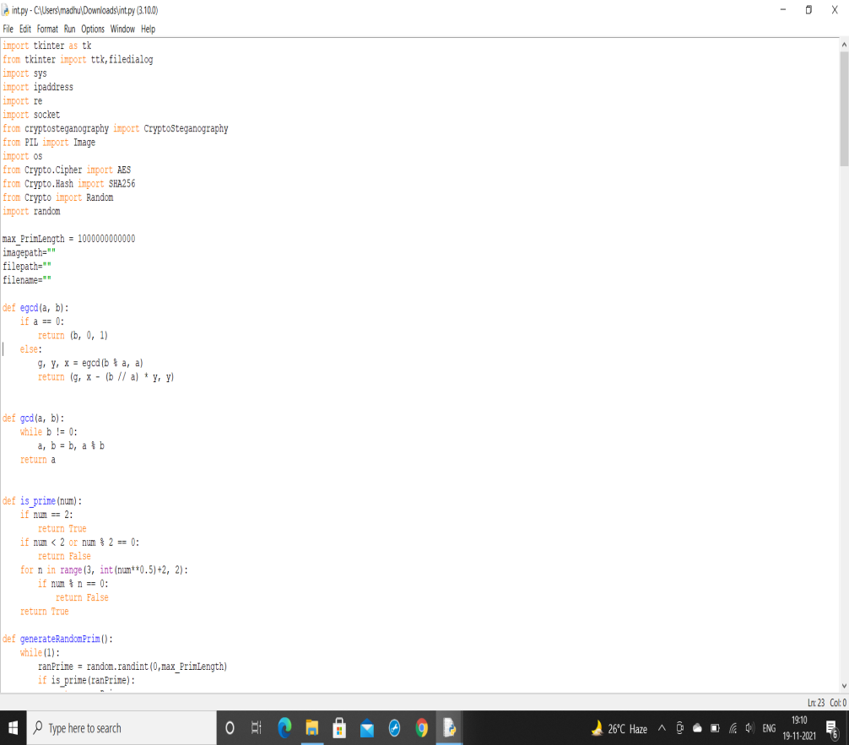
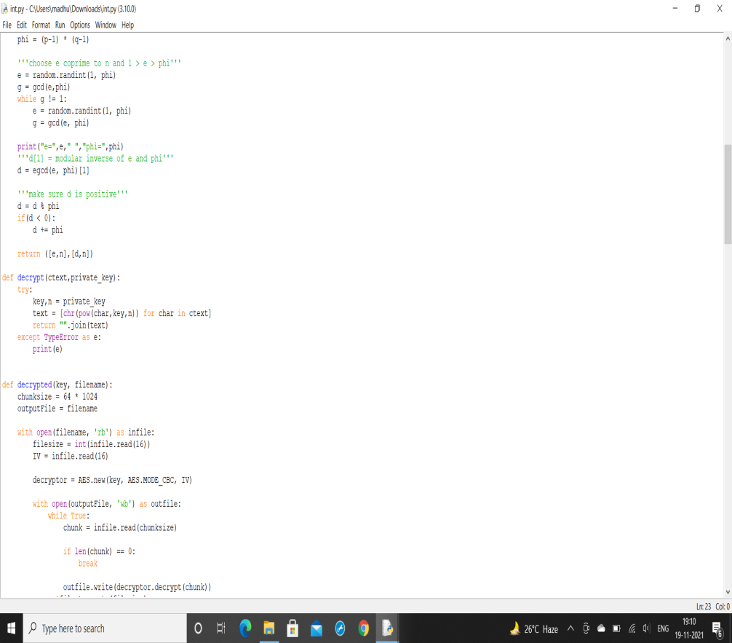
EXPERIMENTAL INVESTIGATION

Slide 13
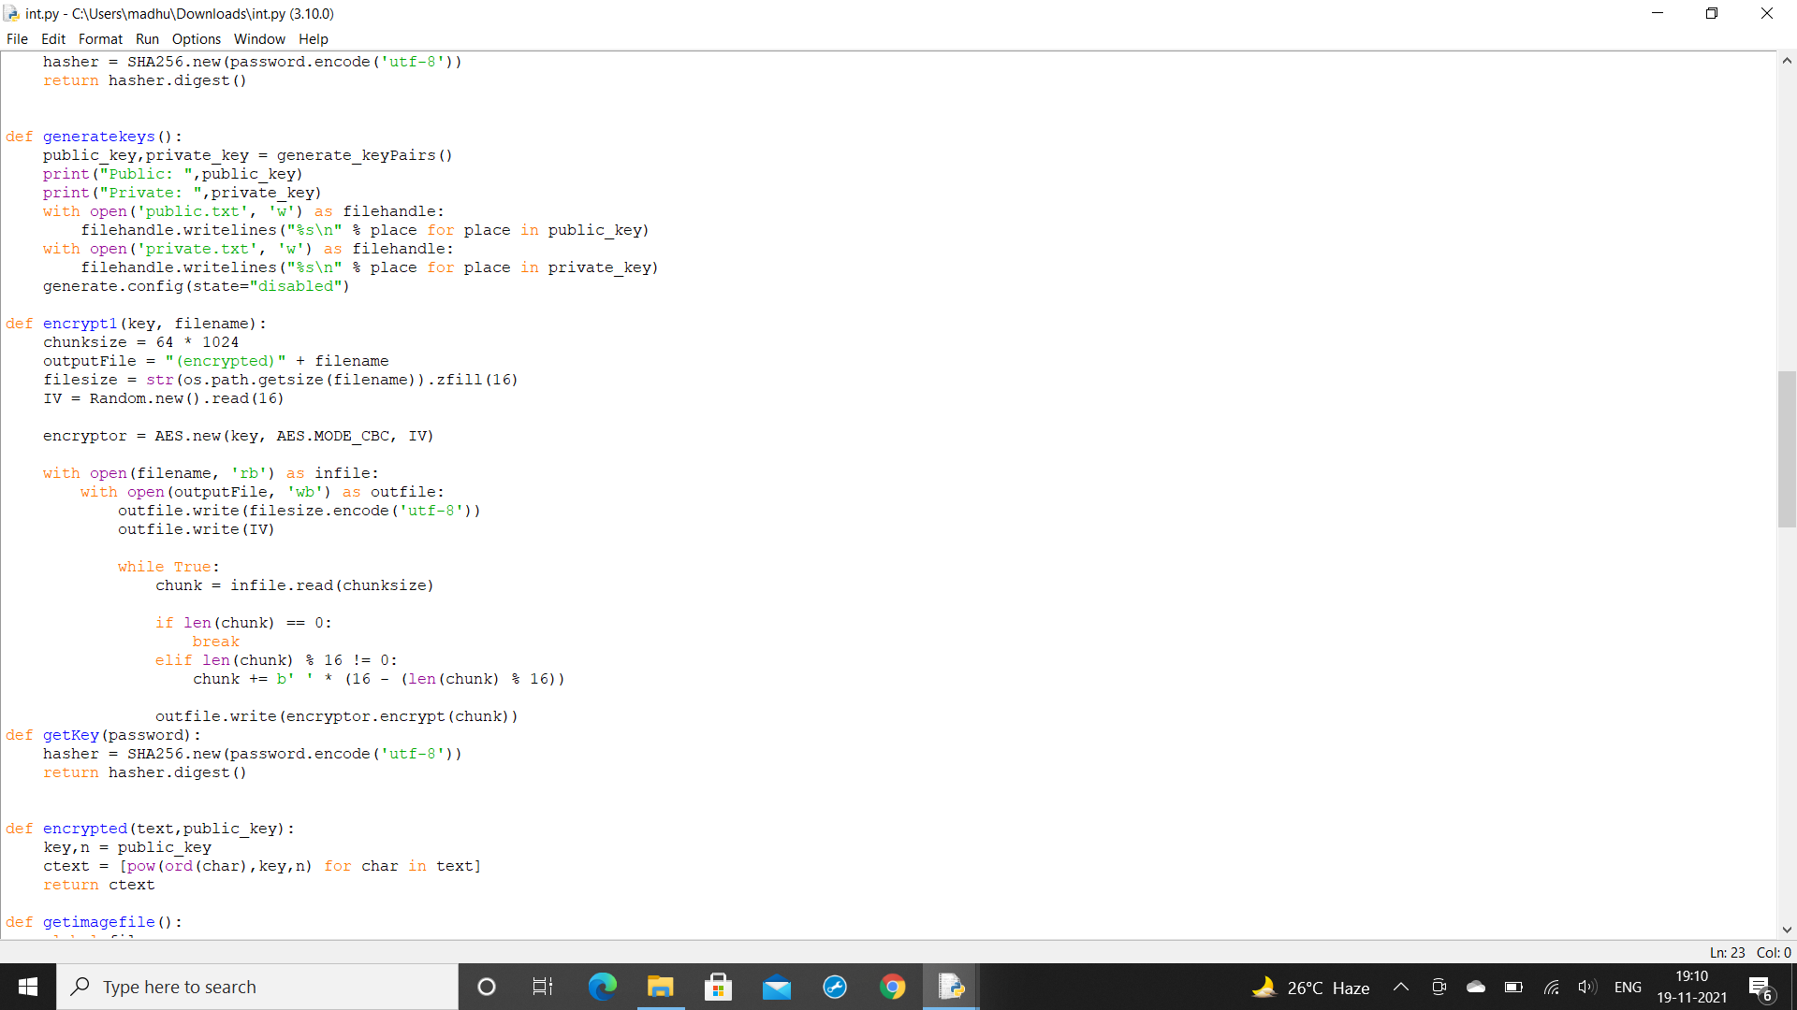
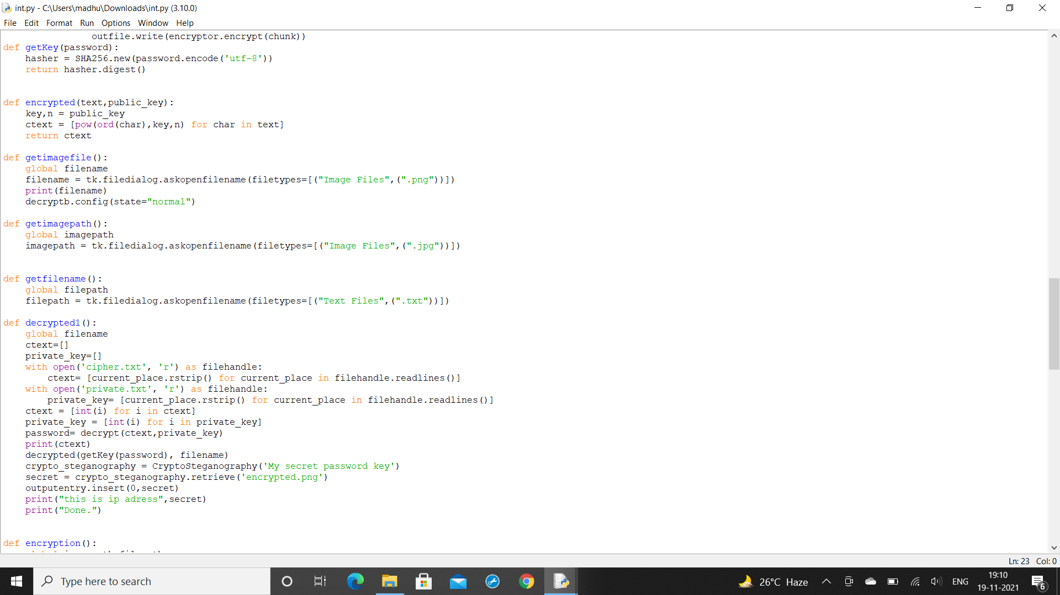

Slide 14
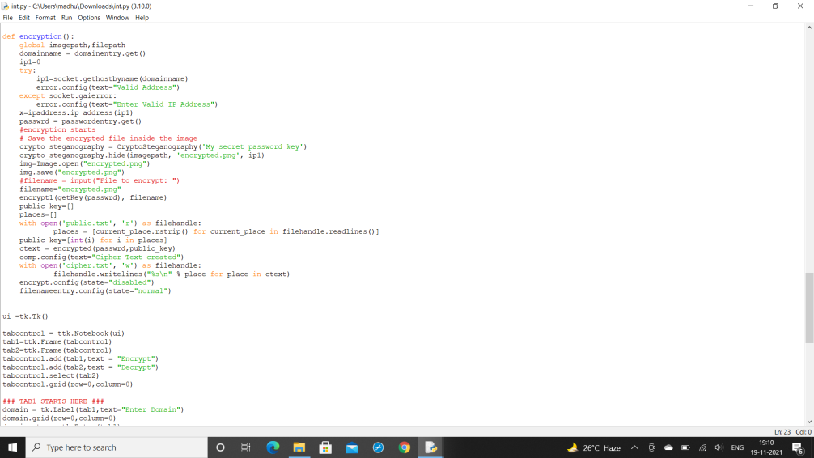
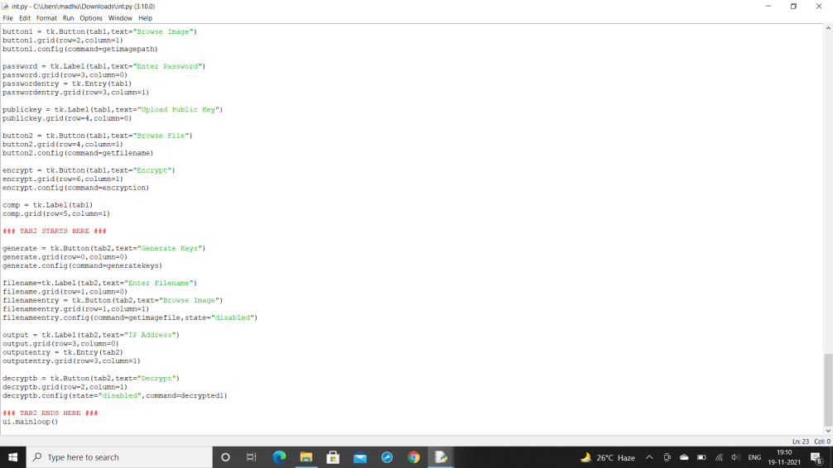

Slide 15
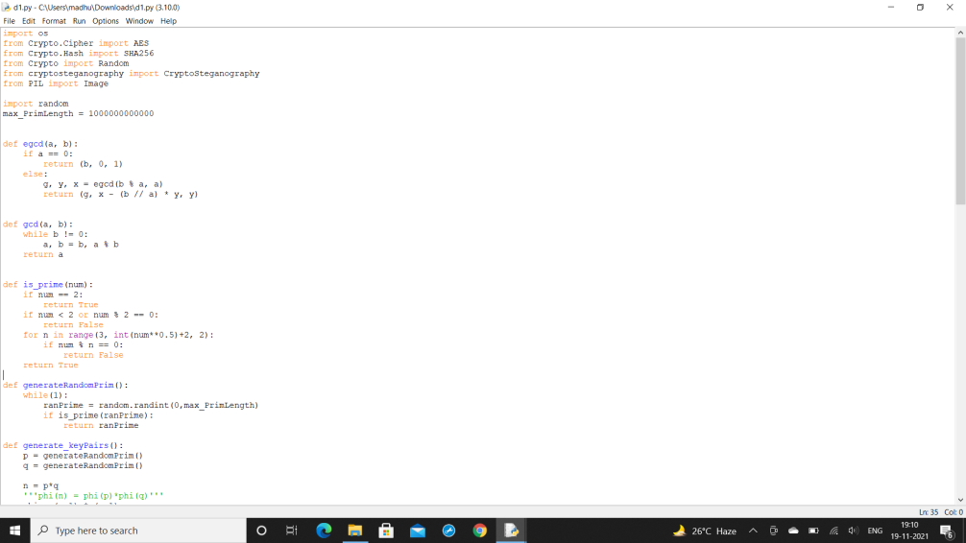
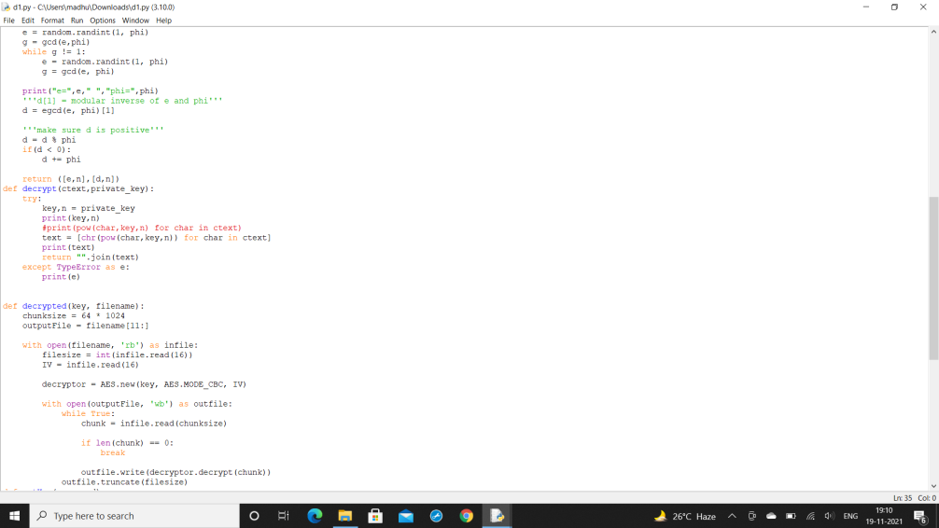

Slide 16
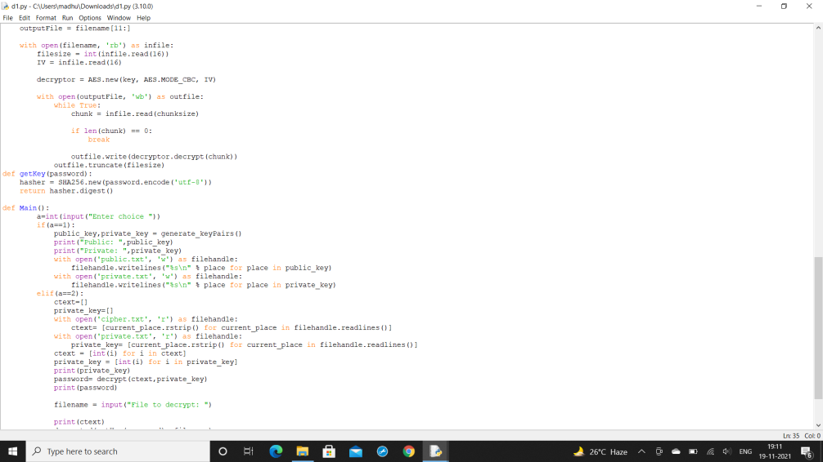
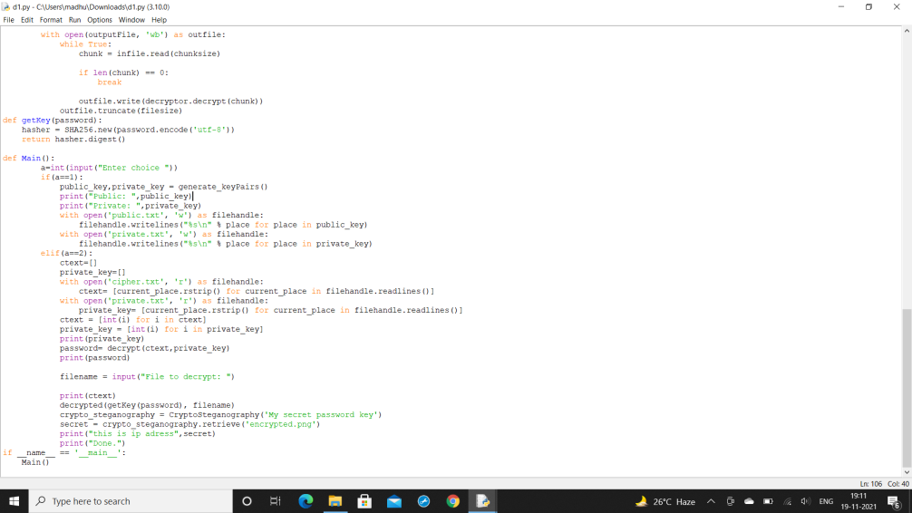

Slide 17
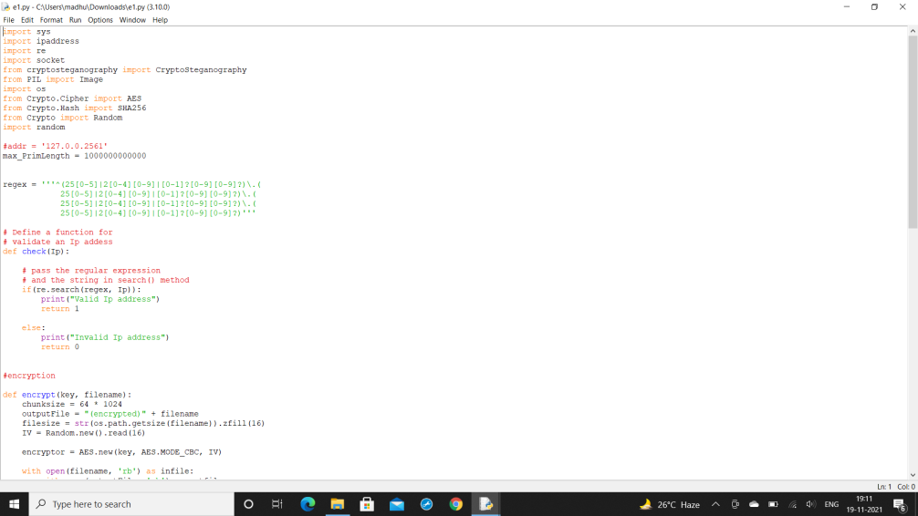
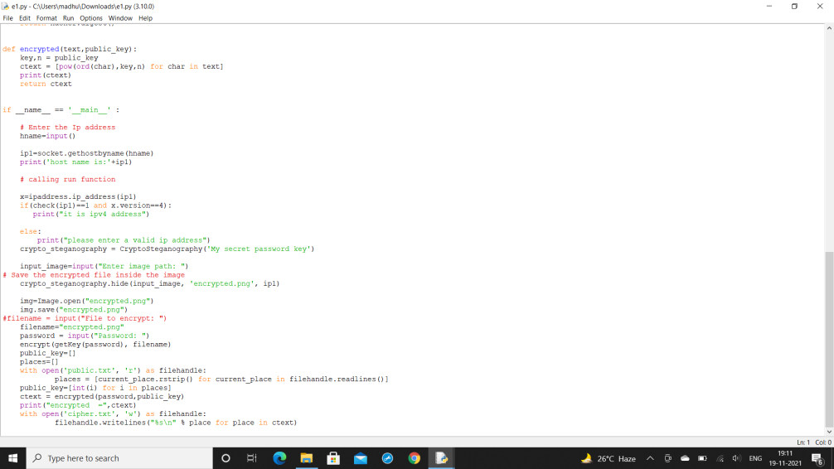

Slide 18
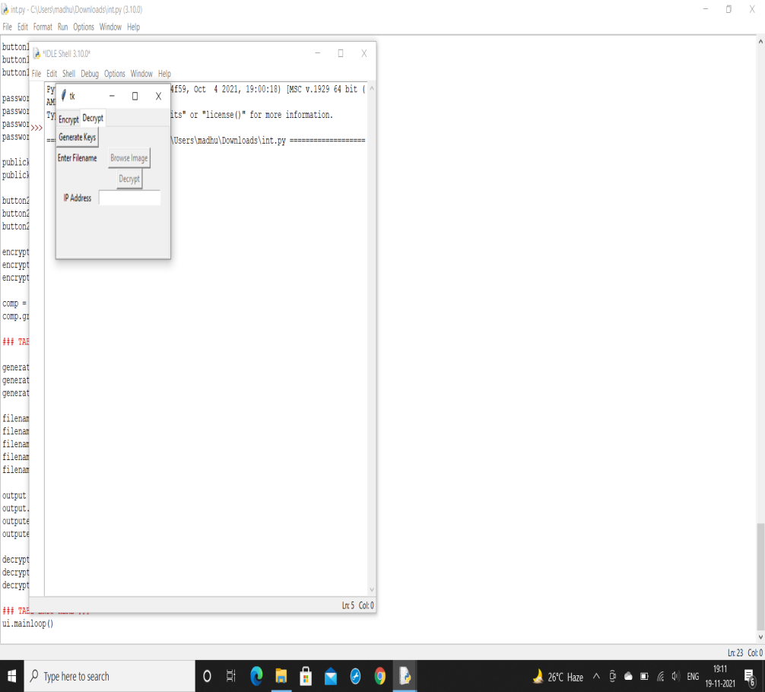
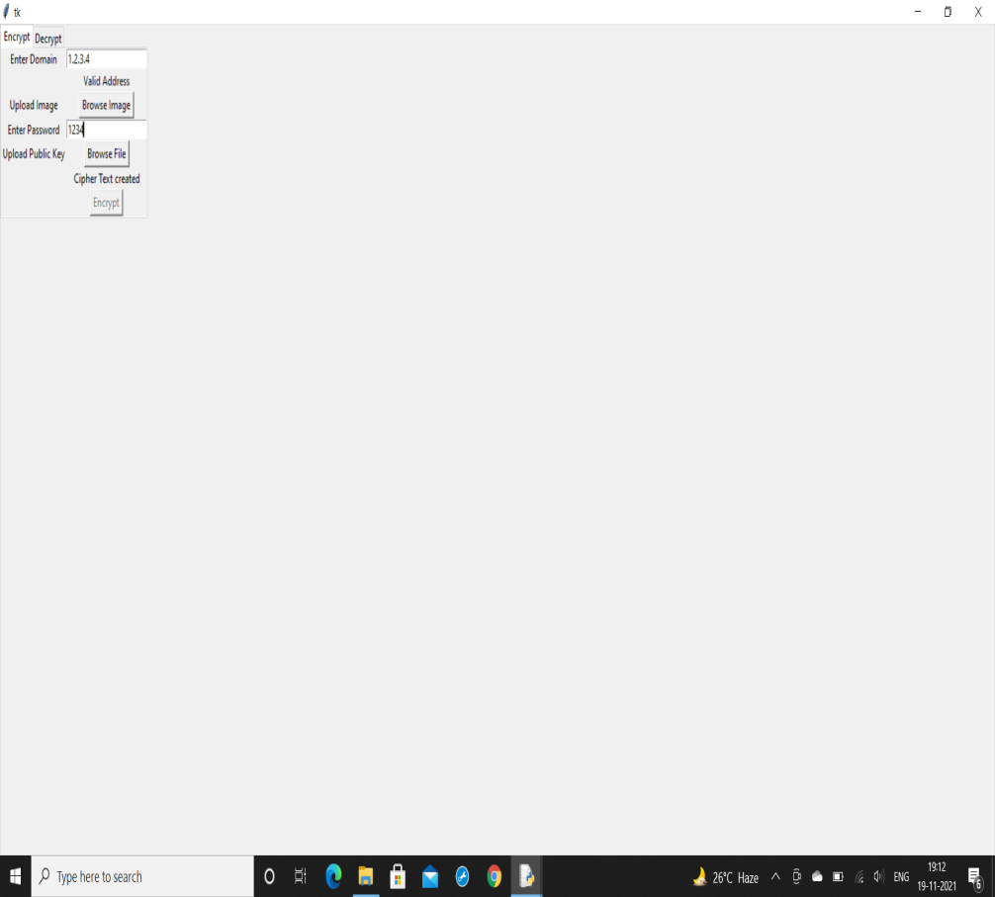
RESULTS

Slide 19
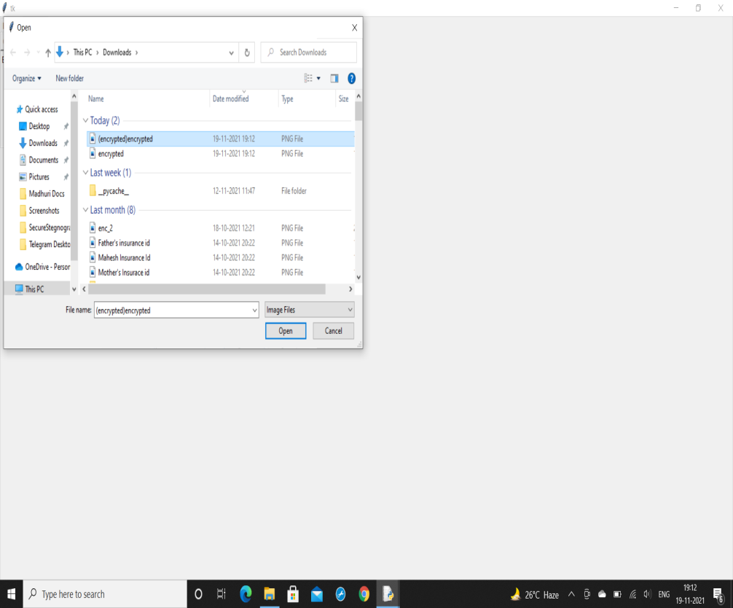


Slide 20
CONCLUSION
As Nowadays people are depending mostly on network for getting their work done effectively and fastly many attacks are increasing regarding credit cards and money being stolen etc... Due to loss of our personal information these type of systems will be more helpful so that no can easily get attacked.
So we used cryptography and steganography to create double layer security in this system. LSB - Steganography is a stego technique where we hide data inside an image by replacing Least significant bit of image with bits of message to be hidden.
Despite the current theoretical attacks and any potential side-channel attacks, AES and RSA itself remains secure. The RSA algorithm is an asymmetric cryptography algorithm, which means it encrypts data using both public and private keys.
AES encrypts a text to a cipher text, which can be decrypted back to the original text by using common private key. Because only two people have access to the private key, an attacker will have a difficult time decrypting it. The encrypted message is created by encrypting plain text with the RSA method. i.e RSA cipher text is now considered as plain text then again encrypted using AES algorithm which result in double encryption. We have used 2 different types of cryptography algorithms which are more faster and provide best and strong security than other algorithms.

Slide 21
REFERENCES
[1]. Huang, C.-W., Che-Hao Chiang, Chien-Lun Yen, Yi-Cheng Chen, Kuo-Huang Chang, & Chi-Jeng Chang,”The AES Application in Image Using Different Operation Modes ”, 2018.
[2]. Sulaiman, Rahmat; Kirana, Chandra; Sugihartono, Tri; Laurentinus, ; Panca Juniawan, Fransiskus,” RC4 Algorithm and Steganography to Double Secure Messages in Digital Image”, 2020.
[3]. Amelia Devi Putri Ariyanto, Eko Hari Rachmawanto, De Rosal Ignatius Moses Setiadi, Christy Atika Sari,” Performance Analysis of LSB Image Steganography Combined with Blowfish-RC4 Encryption in Various File Extensions”, 2019 .

Slide 22
[4]. U. A. Md. Ehasn Ali1 , Md. Sohrawordi1 , Md. Palash Uddin1 1,” A Robust and Secured Image Steganography using LSB and Random Bit Substitution”, Bangladesh, 2019.
[5]. Ako Muhamad Abdullah , Cyprus," Advanced Encryption Standard (AES) Algorithm to Encrypt and Decrypt Data”, Eastern Mediterranean University – Cyprus, 2017.

Slide 23


